Slide 1
Atomic Emission Spectroscopy
Ponte - CHEM 377 Laboratory

Slide 2
Purpose
The experiment used atomic emission spectroscopy to determine the concentration of lithium in an unknown mixture solution (unknown N.1) of lithium and strontium.
As part of the determination, a calibration curve was constructed using the external standards method and a spectral strip was performed.
The experiment also served to demonstrate the advantages and disadvantages of using a photodiode array as opposed to a scanning monochromator.

Slide 3
Results
Concentration of Lithium in the Unknown:
(1.19 ± 0.23) ppm for averaged replicate values
(1.19 ± 0.14) ppm for all replicate values

Slide 4
Instrumentation

Slide 5
Basic Set-up
Notes:
Sample (which is directly fed into the apparatus)
Nebulizer
Atomizer – Flame
Monochromator
PDA
Read-out Device

Slide 6
Instruments Used:
Ocean Optics USB2000 Spectrometer with SMA 905 optical fiber tip
IOOBase32 software to record all spectral data
Notes:
- In other words, a PDA device with a read-out that measures intensity of the peaks in the spectrum in arbitrary units called ‘counts’
- The detector gets saturated at 4000 counts, meaning any peak greater than that will be clipped (so work at 2000-3500 counts range)

Slide 7
Sample Introduction
Sample converted to spray by nebulizers
High temperature of flame then causes solvent to evaporate: desolvation
Further heating volatizes the particles,
Possible dissociation
Notes:
The sample introduction process is as follows:
Sample is first converted into spray by a nebulizer
Then, high temperature of the flame causes the solvent to evaporate, leaving dry aerosol particles (this step is called desolvation)
Further heating volatizes the particles, producing atomic, molecular, and ionic species
Dissociation of these molecules to produce atomic gas
Some molecules in the gas ionize to form cations and electrons, other molecules and atoms are produced in the flame as a result of interactions of the fuel with the oxidant and with the various species in the sample

Slide 8
Nebulizer
Pneumatic Nebulizers
Concentric tube (in this experiment)
Ultrasonic Nebulizers
Other ways to atomize:
Electrothermal vaporizers
Hydride Generation Techniques
(1)
Notes:
The purpose of the nebulizer is to transfer a reproducible and representative portion of the sample into the atomizer with high efficiency and no adverse interference effects
In this experiment, direct nebulization was used: the nebulizer constantly introduces the sample in the form of a fine spray of droplets (which we can call aerosol)
There are two main types of nebulizers: pneumatic and ultrasonic
Four types of pneumatic nebulizers are shown here
The most common is the concentric tube, also called the Meinhard nebulizer, (this was the nebulizer used in this experiment) where liquid is drawn through capillary tube by a high-pressure stream of gas flowing around the tip of the tube (so the Bernoulli effect)
The advantages of the Meinhard nebulizer: very fine spray produced, good mixing, quiet and noise stable, and a consumption of 4ml/min
Fritted disk nebulizer: much finer aerosol than the first two
Babington nebulizer: less subject to clogging than other devices and is therefore useful for sample that have significant particulate content
In an ultrasonic nebulizer, sample is pumped onto the surface of a crystal that vibrates at a high frequency
Produces more dense and more homogenous aerosols than pneumatic nebulizers do (but have low efficiencies with viscous solutions and solutions containing particulates)
Spoilers are used to put large droplets out through drain and ensure a fine uniform mist is created.
The sample is thus nebulized by a flow of gaseous oxidant, mixed with a gaseous fuel, and carried into a flame where atomization occurs

Slide 9
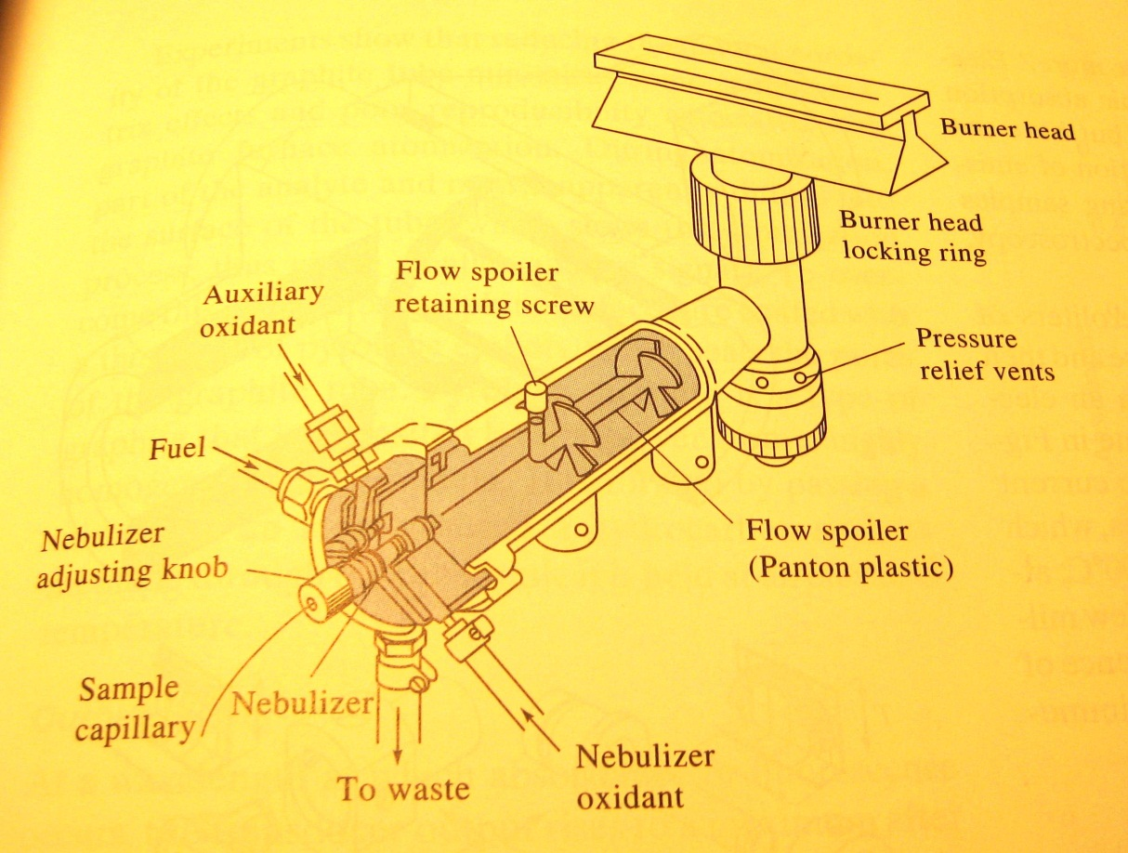
Flame Atomizer
Temperature of 1700-2400
Dependent on oxidant and fuel
Gas flow and flashback
Critical step: limit of precision
(1)
Notes:
The Flame, created by the burner head (of which here a slot burner head is shown in this diagram), is the essentially the source in the instrument (the electrons in the analyte atoms are excited by the thermal energy in the flame, thus the sample is the source of photon emissions through relaxation).
It is a continuous atomizer
Two burner types discussed are the slot and Meeker burner heads.
The Meeker head is not particularly good for atomic absorption, but is good with emission and fluorescence
These burner heads are designed so that different gases can be directing into inner and outer ports, which serves to reduce flame background and quenching and imparts more stability
Two important considerations are at play here:
The same part of the flame must be focused on the entrance slit for all calibration and analytical measurements (as there are differences in temperature profiles, which subsequently leads to…)
Different portion of the flame should be used for the best determination of different elements
The temperature of the flame depends on the oxidant and fuel used
With air as the oxidant, (and say acetylene as the fuel – common fuel), the temperature is of 1700-2400 degrees Celsius
For a hotter flame, nitrous oxide or oxygen must be used as the oxidant
Burning velocity are also important, and are stable only in certain ranges of gas flow rates → the goal is a stable flame
Gas flow rate is also essential to prevent flashback, the propagation of the flame below the burner head slot and back into the mixing chamber (gas flow velocity has to exceed burning velocity)
Atomization is a critical step: it is the ‘Achilles’ heel’ of the instrument and limits the accuracy, precision, and the detection limits of measurements

Slide 10
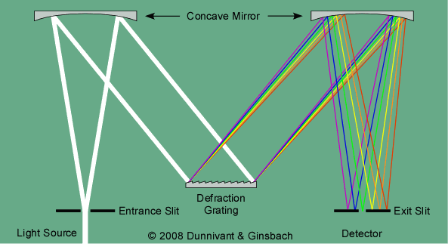
Monochromator
(2)
Notes:
The emission from the flame travels through the entrance slit to the monochromator, which serves the purpose of transmitting mechanically selectable narrow band of wavelengths
The key components of the monochromator ( a Czerney-Turner shown here) are the mirrors (which collimate and reflect the light), and the diffraction grating
The diffraction grating is equivalent to many narrow, equally spaced slits, which make the regions of constructive interference very narrow, so that instead of a sinusoidal variation in intensity, a series of narrow bright bands appear on the detector
An echelle grating achieves high dispersion while maintaining a high diffraction intensity by making the angle and order of diffraction large (in terms of the grating equation which quantitizes pathlengths in terms of distance between grating and the incident angle)
The echelle grating allows more powerful imaging and detectors to be used in emission spectrometry where spectral overlap can be a problem

Slide 11
Detector: Photodiode Array
Intensity versus pixel position
Resolution limited by pixel configuration
Compare with scanning monochromator
Multiple wavelengths at a given time
Notes:
The emissions are detected using a photodiode array (PDA)
At PDA is fixed at the exit plane and get spectral information all at once for all wavelengths because light intensity as a function of position in the exit plane is recorded over the full wavelength range of the spectrometer with each measurement
PDA systems function by reading data in as intensity versus pixel position
Thus, resolution is limited by pixel configuration and size: each pixel corresponds to specific wavelength
Subsequently, software converts pixel position to wavelength based on polynomial fitting of signals
In the past, this experiment was performed using a scanning monochromator: PDA systems are preferred over scanning monochromator PMT systems.
The mechanical motion of the grating in the scanning monochromator is time ineffective and the lack of this makes the PDA system more robust and suitable for field use
Furthermore, the scanning monochromator cannot scan for multiple wavelengths at the same time like the PDA can
However, the scanning monochromator can read data that would be narrower than the pixels in the PDA – difference in optical properties between the two when the PMT is used as detector
The resolution value for the scanning monochromator is significantly smaller (this was determined in the SN experiment by a comparison of the reciprocal dispersion values for both systems – the scanning monochromator was smaller)

Slide 12
Read-out Software
IOOBase32 Software
2048 pixels covering wavelength range of 650 nm
Parameters:
Integration time
Number of averaged spectra
Modes:
Spectral acquisition mode
Time acquisition mode (S/N)
Notes:
The intentisty of the peaks in the spectrum is measured in arbitrary units called ‘counts’
Many settings to control and alter the appearance and intensity of the spectrum, the two most important parameters are integration time and number of averaged spectra
Integration time is the time that the individual diodes (pixels) in the array are allowed to respond to light before they are read out and reset to zero
The diodes respond linearly to light until they approach saturation
Longer integration times allow lower light levels to be seen (more photons build up in capacitors before sent to electronics)
Number of averaged spectra controls how many spectra are averaged before appearing on screen
When acquiring data at different integration times, care must be taken to ensure that the resulting spectra are comparable and can be used together in calculations
Total acquisition time in this experiment was 1 second
The software can run in two modes: spectral acquisition mode and time acquisition mode
Spectral acquisition mode show the raw signal for the entire wavelength of the detector
Time acquisition mode replicates intensity of data at one wavelength for a certain time period (this is used for Signal-to-Noise data acquisitions which would otherwise require saving the entire spectrum multiple times)

Slide 13
Theory of Excitation and Emission

Slide 14
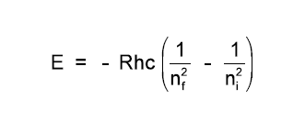
Electronic Transitions
Resonance and nonresonance
Bohr’s Equation relates electronic transitions to energy, frequency, and wavelength
(2)
Notes:
Spectroscopy is the study of energy transitions
When energy (in other words, a photon) is absorbed, the electronic state is changed.
Excitation of electron to higher orbitals can be brought about by the heat of a flame, a plasma, or an electric arc or spark, and so on.
Lifetime of an excited atom is brief and its return to the ground state, relaxation, results in photon emission
Depending on the electronic transition, this phenomena can be observed by the naked eye: the visible spectrum (350 nm – 800 nm)
In AES we are only concerned with the absorption of a photon by the ground state atomic species, and the emission of photon from a singled electronic level
This results in resonance lines – which are observed from transitions between an excited electronic state and the ground state
Bohr’s Equation relates electronic transitions to energy, frequency and wavelength

Slide 15
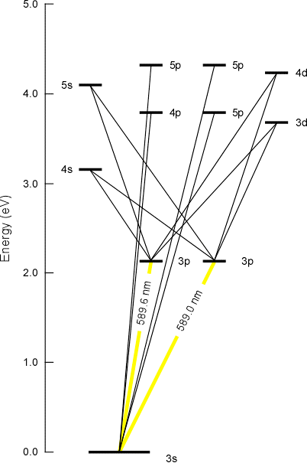
Resonance of Sodium
(2)
Notes:
This diagram shows the possible electronic transitions for a 3s electron in a sodium atom
The most prominent wavelengths produced are characteristic of sodium, the yellow band observable at 589.6 nm and 589.0 nm

Slide 16
The Experiment

Slide 17
Flame Background Spectra
Notes:
Before running any samples through the AES instrument, the flame background spectra was obtained.
This allowed for a spectral comparison of the wet and dry flame.
The wet flame was taken by submerging the end of the plastic sample line in the blank solution of deionized water.
The dry flame was the emission from when the sample line was not in any liquid
What is observed is that the intensity of the dry flame is greater than that of the wet flame
This is probably not a result of chemical differences, but just due to the lower temperature of the wet flame by its nature of evaporating water droplets

Slide 18
Lithium Standards
Notes:
The purpose of the experiment was to determine the concentration of lithium in an unknown sample. To do this, we use the method of external standards to create a calibration curve that then allows us to determine the concentration in the unknown sample using it’s measured signal.
The method of external standards assumes the following:
Standards should have the same matrix effect as the sample
Blanks should contain all the components of the analyzed sample with the exception of the analyte
All signals should be blank corrected
In order of increasing concentration, each Li standard solution – of concentration 0.1 ppm, 0.25 ppm, 0.5 ppm, 1.0 ppm, and 2.5 ppm – was run.
The averaged peak signals were scaled to compensate for the use of different integration times; the average spectral signals were divided by their respective integration times. The standards were also blank corrected by subtracting the scaled blank correction factor, 0.08348 counts/ms -determined from average of replicate blank measurements- from the averaged, scaled standards.

Slide 19
Lithium Standards
Lithium Wavelength used: 671.16 nm
Notes:
To construct the calibration curve, the intensity, in counts, was obtained at the maximum emission wavelength of 671.16 nm for the five standards and a triplicate blank measurement.

Slide 20
External Standard: Calibration Curves
Notes:
Two calibration curves were constructed: one using averaged replicate values, the other using all replicate values.
In order to get a more realistic outcome of the calibration curve, another calibration curve was then constructed using all replicates.
In this case (where all replicates were used), there was a greater degree of freedom and thus a smaller experimental variance of concentration corresponding to the measured signal.
Here, the determined unknown concentration is shown in red with it’s corresponding error bars

Slide 21
Figures of Merit
Table: Figures of Merit for the Lithium Calibration Curve Using Method of External Standards
Limit of Detection | 0.001061
Limit of Quantitation | 0.003535
Sensitivity | 20.61539
Notes:
The analytical method is characterized by the parameters: limit of detection, limit of quantitation, and sensitivity
Limit of detection (LOD) is is the smallest detectable concentration in a sample within a specified level of confidence – in other words, the minimum concentration that one can measure above the ‘noise’ of an instrument
The limit of detection is calculated as LOD=(k*Sbk)/m, where k is factor set at 3, Sbk is the standard deviation of the blank measurement, and m is the slope
It was found to be 0.001061 ppm
Historically, detection limits have improved little since the 1960s
As a consequence, there is a ‘chasing of the detection limit’, where one of the goals of instrumental manufacture is to improve instruments to measure smaller and smaller quantities of analytes
sample introduction techniques such as hydride generation and graphite furnace have greatly improved detection techniques for a few elements
The limit of quantitation is the smallest analyte concentration with which it is possible to take a measurement.
The LOQ is calculated in the same manner as the LOD, except the factor k is set at 10: LOQ = (10*Sbk)/m.
For the lithium standards, the limit of quantitation was found to be 0.003535 ppm
The calibration sensitivity is characterized by the slope of the calibration line

Slide 22
Spectral Strip
Notes:
A spectral strip was done to remove the interfering strontium signal so that the lithium peak is the only remaining element of the unknown spectrum after the strip.
To perform a spectral strip, a blank, a strontium standard, and the unknown mixture were run through the instrument using the same settings.

Slide 23
Spectral Strip
Notes:
Both the mixture spectrum and the strontium spectrum were then blank corrected by subtracting the entire blank spectrum from both spectrums.

Slide 24
Spectral Strip
Notes:
The strontium spectrum must then be removed from the unknown spectrum.
This can only be done if the strontium peaks of the unknown spectrum are of the same intensity as those in the strontium spectrum.
The intensity was not the same in this experiment
thus the strontium standard intensity had to be scaled to the intensity of the strontium present in the unknown.
The scaling ratio is obtained by dividing the unknown mixture intensity by the intensity of the strontium standard at 605 nm, a wavelength where there is no risk of accidentally stripping the lithium from the unknown.
The strontium values at the wavelength 671.16 nm were then multiplied by the scaling ratio, 0.305, and subtracted from the unknown blank-corrected spectra at that wavelength, which is the characteristic wavelength of lithium as discussed before

Slide 25
Spectral Strip
Notes:
- This slide shows the spectral stripping process focusing on the wavelength range of interest

Slide 26
Spectral Strip
Table: Unknown Lithium Concentration and Associated Error From Calibration Curves
Scaling Ratio (Unknown/Sr at 605 nm) | 0.305293
Scaled Strontium at 671.16 nm | 8.372391 counts/msec
Unknown Signal Stripped at 671.16 nm | 20.61539 counts/msec
Unknown Lithium Concentration | 1.19 ppm
Error (using averaged replicate values) | ± 0.23 ppm
Error (using all replicate values) | ± 0.14 ppm
Notes:
This table shows a summary of the calculations performed to find the unknown concentration at it’s associated error at the 95% confidence level for both calibration curves

Slide 27
Sources of Error

Slide 28
Noise Sources
Chemical Noise
Instrumental
Thermal
Shot
Flicker
Line Broadening
Doppler Effect
Temperature
Pressure
Notes:
There are both chemical and instrumental sources of noise to consider
Chemical noise arises from lots of uncontrollable variables that affect the chemistry of the system being analyzed
EX: undetected variations in temperature or pressure
Instrumental Noise is associated with each component of an instrument
Certain kinds of instrumental noise are recognized: Johnson noise, shot noise, flicker noise, and environmental noise
Johnson noise is caused by thermal agitation of electrons or other charge carriers in elements of the instrument
Dependent on frequency bandwidth by independent of frequency itself
Can be decreased by decreasing bandwidth
Also overcome by cooling specific components of the instrument, such as is done in advanced detectors
Shot noise results from current being generated by premature movement of electrons across a junction – also called quantum noise
Flicker noise is characterized by having a magnitude that is inversely proportional to the frequency of the signal being observed
An example is long-term drift in instruments
Can be reduced by using wire-wound of metallic film resistors
Line broadening as a result of the uncertainty effect, the doppler effect, pressure and temperature effects
Doppler effect happens when atom moves towards photon detector and emits radiation, and the detector sees wave crests more often and detects radiation of higher frequency
In flames, doppler broadening causes lines to be about two orders of magnitude wider than the natural line width
Pressure effects arise due to collisions between atoms of the same kind and with foreign atoms (small changes in energy levels and hence a range of absorbed or emitted wavelengths)
In flames, collisions between analyte atoms and the various combustion products of the fuel
Temperature has effect on the ratio between the number of excited and unexcited atomic particles in an atomizer (this magnitude can be calculated from the Boltzmann equation)
Emission measurements are made on this fraction of the analyte, so this is important
Also, influence the degree of ionization of the analyte and thus the concentration of nonionnized analyte which the analysis is based

Slide 29
Signal to Noise
Notes:
As we can see in this graph, the signal to noise ratio for the experiment (as obtained using the time acquisition mode), demonstrates flicker and quantum noise (sharp rise and subsequent plateau-ing of the curve – we can take out the lower point since with error we always want to strive to get the best possible approximation)
Quantum noise is important at low light levels and flicker dominant at high

Slide 30
Q/A

Slide 31
References
“AES, Flame Atomic Emission Spectroscopy.” Chemistry 377 Manual. McGill, 2012.
CRC Handbook of Chemistry and Physics. 64th edition. R.C. Weast –ed., CRC Press, Inc., Boca Raton, Florida, 1983-84.
Dunnivant, and Ginsbach. Flame Atomic Absorbance and Emission Spectroscopy and Inductively Couples Spectrometry – Mass Spectrometry. Whitman College, 2009.
Salin, E. Chemistry 277: Course Handout. McGill, 2012.
Skoog, D.A., Holler, J., Crouch, S.R.. Principles of Instrumental Analysis. 6th edition. Brooks and Cole, 2007.

Slide 32
Image References
(1) Skoog, D.A., Holler, J., Crouch, S.R.. Principles of Instrumental Analysis. 6th edition. Brooks and Cole, 2007.
(2) Dunnivant, and Ginsbach. Flame Atomic Absorbance and Emission Spectroscopy and Inductively Couples Spectrometry – Mass Spectrometry. Whitman College, 2009.

